Slide 1
Mental Capacity Deputyship Lasting Power of Attorney
Dr Zoe Picton-Howell Solicitor (Hons)
The Adam Bojelian Foundation CIC
https://theadsfoundation.org

Slide 2
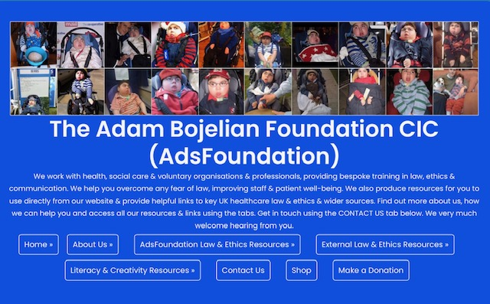
https://theadsfoundation.org

Slide 3

Adam Bojelian 2000-2015

Slide 4
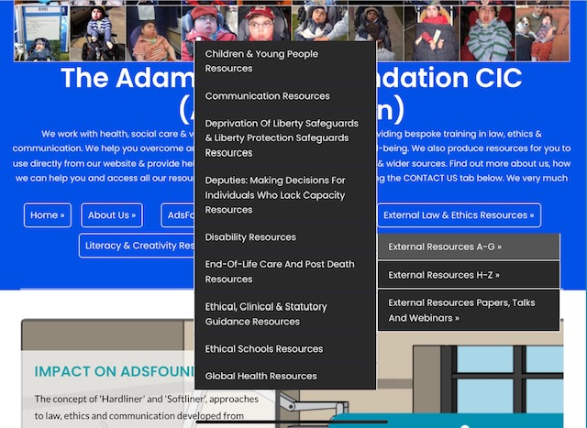
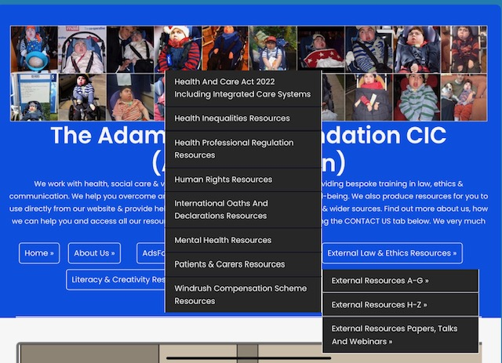
Sample AdsFoundation Resources

Slide 5
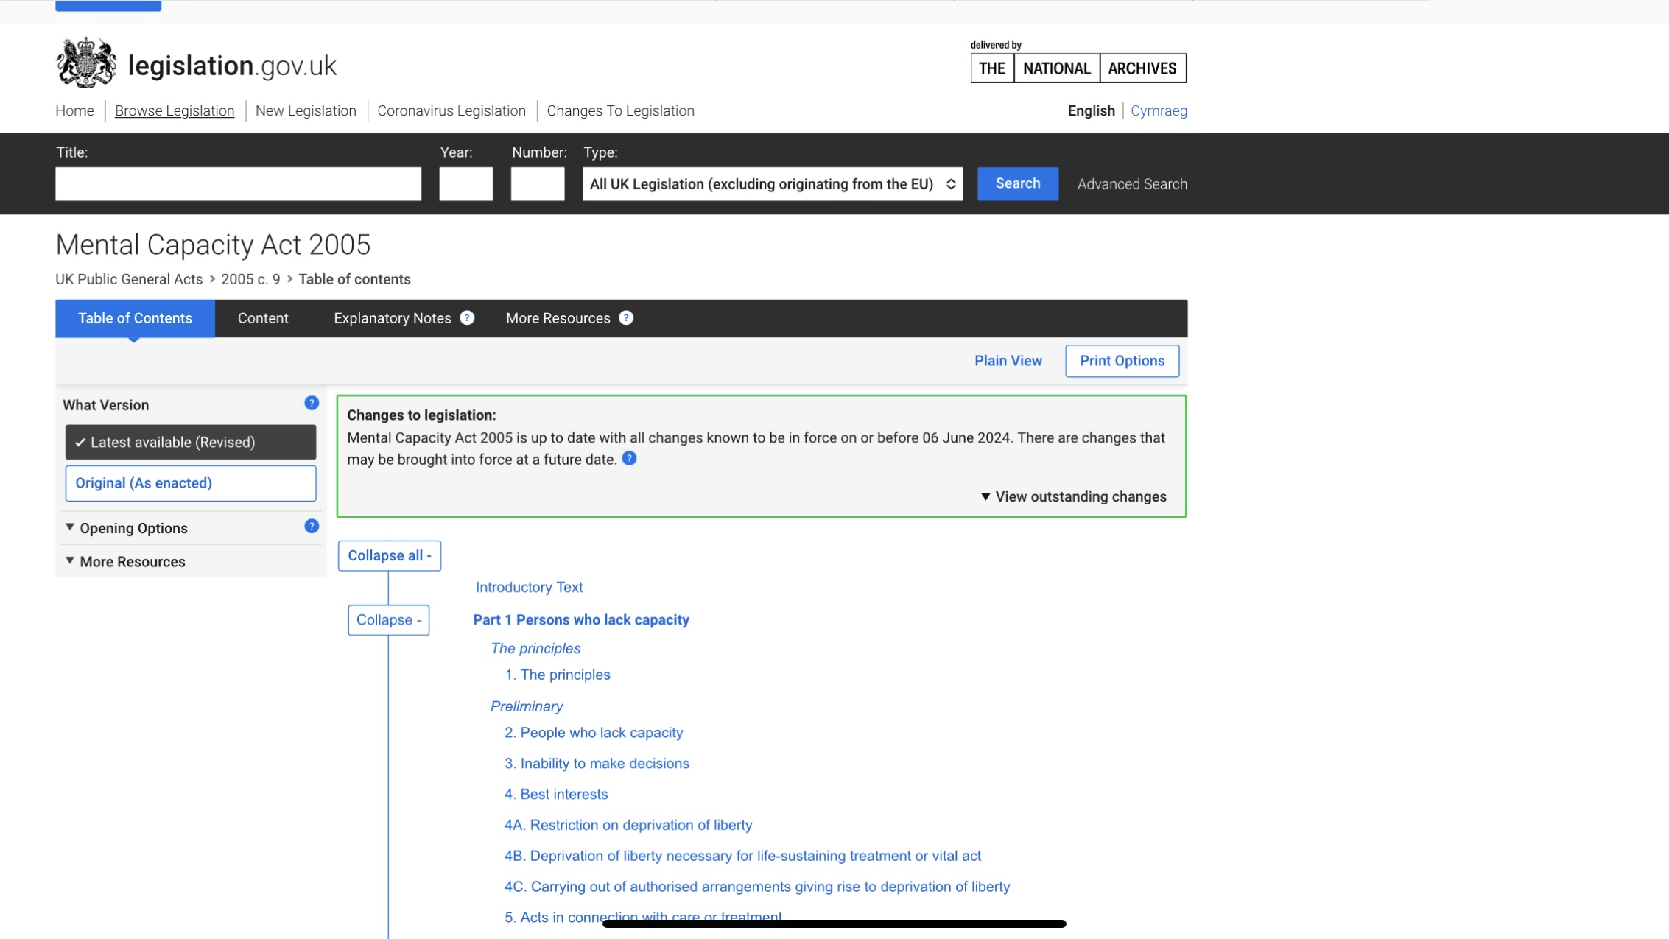

Mental Capacity Act 2005 & Code

Slide 6
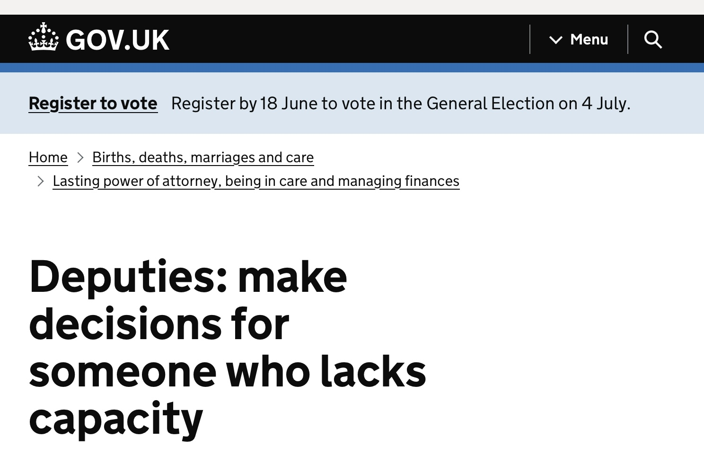
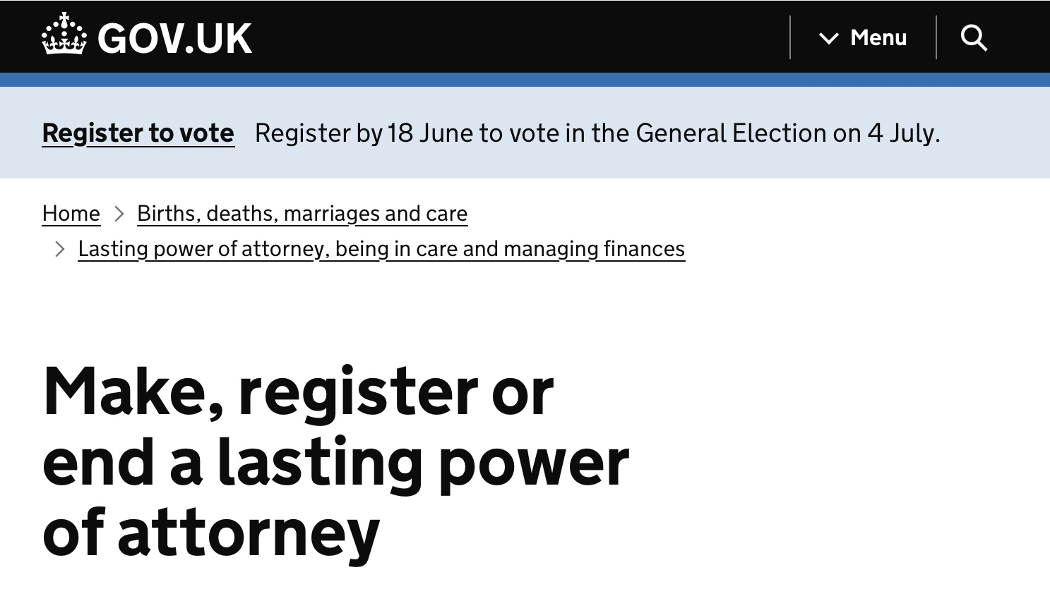
Deputies & Lasting Powers of Attorney

Slide 7
Mental Capacity Act 2005 & Code

Slide 8

UN Convention on the Rights of Persons with Disabilities (UNCRPD) 2006

Slide 9
Legal duty to follow MCA Code
Include anyone:
Acting in a professional capacity
Being paid to carry out actions
Family carers
Any other unpaid carers

Slide 10
‘Lacks capacity’ – see MCA code Chapter 4
A person who lacks capacity to make a particular decision or take a particular action for themselves without help, at the time of the decision or action needs to be taken.

Slide 11
What should you do?
Read and familiarise yourself with the code.
Follow the code.
Clearly document how you have followed the code, including the justification for the decision reached.
Be brave, advocate for your patients and challenge colleagues who are acting unlawfully and ignoring or misunderstanding the code, if necessary, seek support from your professional body.

Slide 12
Additional Guidance available from:
Department of Health and Social Care
Office of the Public Guardian
Court of Protection
Social Care Wales/Gofal Cymdeithasol Cymru
Links to all the above can be found on the disability resources page of https://theadsfoundation.org

Slide 13
The 5 Principles – s1 MCA
A person must be assumed to have capacity unless it is established that he lacks capacity.
A person is not to be treated as unable to make a decision unless all practicable steps to help him to do so have been taken without success.
A person is not to be treated as unable to make a decision merely because he makes an unwise decision.
An act done, or a decision made, under this Act for or on behalf of a person who lacks capacity must be done, or made, in his best interests.
Before the act is done, or the decision is made, regard must be had to whether the purpose for which it is needed can be as effectly achieved in a way that is less restrictive of the person’s rights and freedom of action.

Slide 14
The aim of the MCA is to empower individuals, not restrict them and to ensure as far as possible, within the law, that the decision reflects the individual’s wishes, values, beliefs and feelings.
Aintree Hospital NHS Trust v James [2013] UKSC
Failure to observe the principles may leave organisations vulnerable to legal challenge.
CH v A Metropolitan Council [2017] EWOP 12

Slide 15
Principle 1
A person must be assumed to have capacity unless it is established that he lacks capacity.

Slide 16
Principle 2
A person is not to be treated as unable to make a decision unless all practicable steps to help him to do so have been taken without success.
See Chapter 3 of MCA Code for further guidance

Slide 17
Principle 3
A person should not be judged to lack capacity just because other people think their decision is unwise.
But still duty to protect life where real and immediate risk to life under Article 2 European Convention of Human Rights/Human Rights Act 1998
Fernandes de Oliveira v. Portugal [Grand Chamber ] [2019]- 78103/14
(Confirmed psychiatric hospital had a duty to take steps to protect the life of voluntary patient where there was a real and immediate risk to the patient’s life)
R (on the application of Nicklinson) v Ministry of Justice; R (on the application of AM) v DPP [2014]

Slide 18
Principle 4
Decision, with some very limited exceptions (see MCA & Code) must be taken in the individual’s best interests.
See non-exhaustive list on Section 4 MCA, also chapter 5 of Code.
‘Best interests’ best seen as a process of reaching a decision, rather than a decision.
Must be tailored to the individual.

Slide 19
Principle 5
Before any act is done or decision made on behalf of an individual who lacks capacity, you must first consider whether something else could be done which would interfere less with the individual’s basic rights and freedoms.
Where there are multiple options and uncertainty as to which is in the individual’s best interests, if one option is finite and another potentially reversible later, take the reversible rather than a finite option.

Slide 20
Young People aged 16 & 17 years
Most of MCA applies to 16-17 year olds who lack capacity with 3 exceptions.
Only people over 18 years can:
Make a lasting Power of Attorney
Can make an advanced decision to refuse medical treatment
3. Be made a statutory will by the Court of Protection.

Slide 21
Children under 16 years
Generally, the MCA does not apply, with two exceptions:
Decisions about a child’s property or finances or the appointment of a deputy can all be made by the Court of Protection, if the child lacks capacity when the decision is made and is likely to still lack capacity to make financial decisions when they reach 18.
Offences of ill treatment or willful neglect of a person who lacks capacity within section 2(1) MCA can still apply to victims under 16 years (s.44 MCA)

Slide 22
Lasting Power of Attorney

Slide 23
Types of Powers of Attorney
Health and Welfare - doe medical care, treatment & daily life
Property & Financial Affairs - for managing money, bills & property

Slide 24
Who can make/grant a Power of Attorney?
Over 18 years old
Have mental capacity to grant the Power
Do not have to live in the UK or be a British Citizen

Slide 25
Forms to make/grant a Power of Attorney
Available on Office of the Public Guardian website at:
https://www.gov.uk/power-of-attorney/make-lasting-power

Slide 26
Duties of Attorney include: see also Chapter 7 MCA Code & OPG website
Familiarise self with MCA & MCA Code
Act in accordance with MCA & MCA Code
Ensure Power has been registered with the Office of the Public Guardian
Before making any decision must be sure granter lacks capacity to make that decision at that particular time & circumstance
Act in granter’s best interests

Slide 27
Deputies

Slide 28
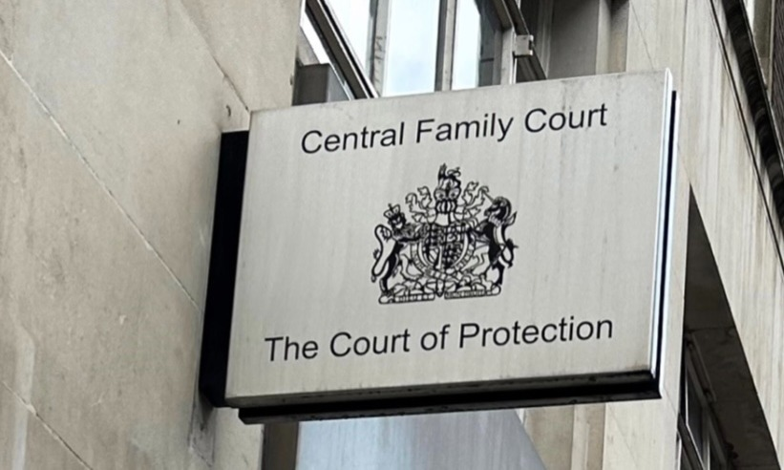
Court of Protection

Slide 29
Types of Deputy
Finance & Property
Personal Welfare
Management of property
Management of finances
Personal care
Medical/nursing care
The Court of Protection provides guidance on the circumstances a personal welfare application should be made.

Slide 30
Who should be appointed?
Over 18 years
Must agree to take on the role
Know the individual concerned well
Have the skills & time required
Be of good standing
If joint appointment, deputies who can work together and reach agreement

Slide 31
COP Forms – all available at gov.uk
COP1 – apply to make decisions on someone’s behalf as deputy
COP1A – apply to make decisions on someone’s behalf – property & finance
COP3 – make a report on someone’s capacity to make decisions
suitable assessors include medical and social care practitioners
COP4 - apply to become someone’s deputy

Slide 32
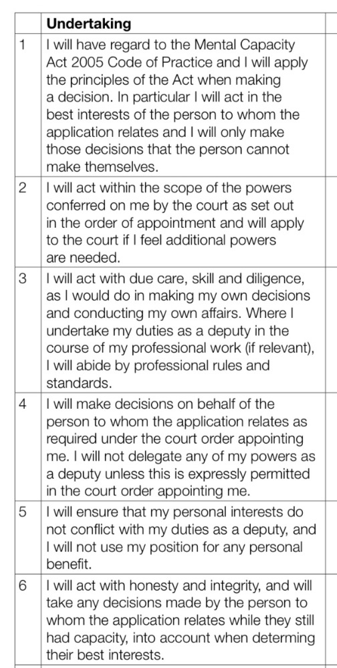
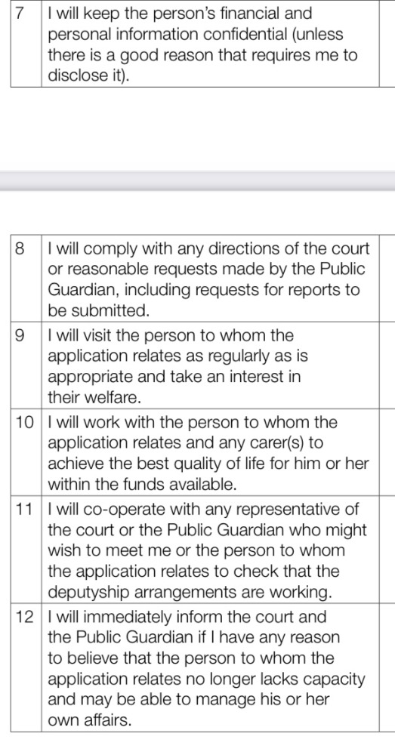
COP 4 Deputy’s Undertakings

Slide 33
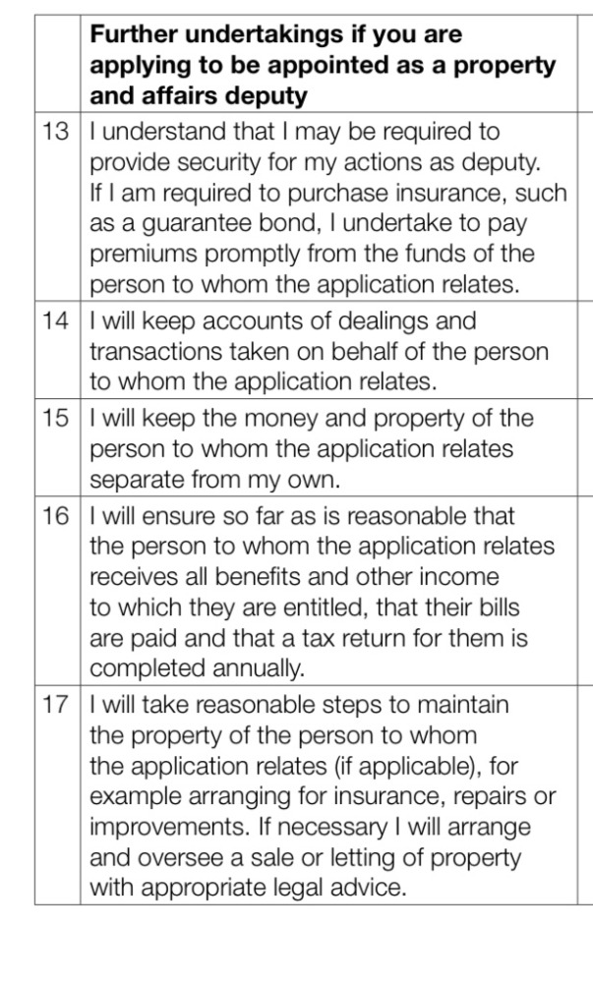
Additional Undertakings for Finance & Property Deputies

Slide 34

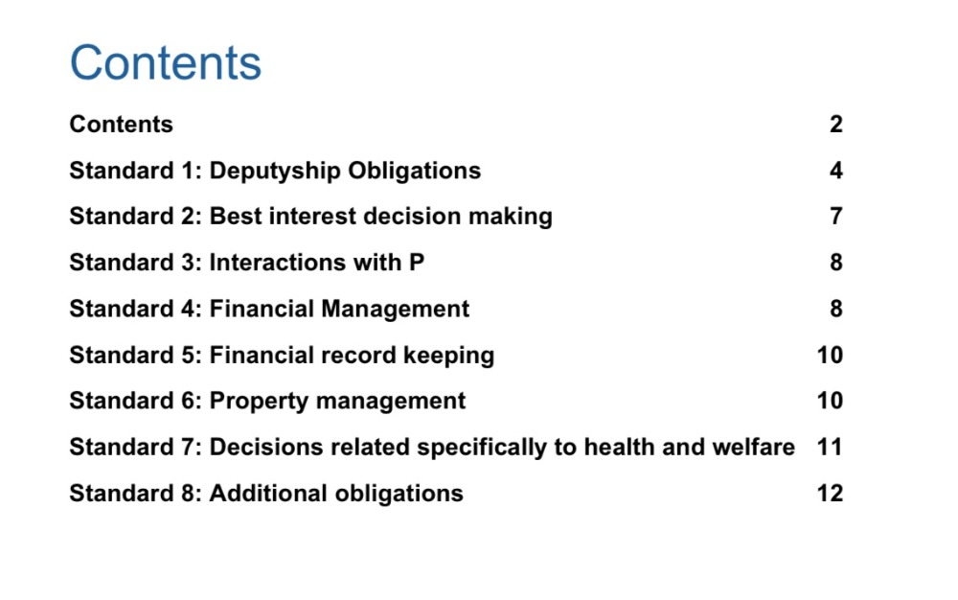
Office for the Public Guardian -Deputy Standards

Slide 35
https://theadsfoundation.org
Go to AdsFoundation Law and Ethics Resources tab
Then to Papers, Talks, Workshops & Webinars
Then to Roald Dahl Nurse 2025
Feel free to share for not-for-profit educational and training purposes

Slide 36
Case Study - Ollie
Ollie is 18 years old and lives with cerebral palsy and epilepsy. He uses a communication device and attends mainstream school. He lives at home with his parents & needs support for daily activities.
Ollie says he wants to grant his sister Chloe (25) a Lasting Power of Attorney for health & welfare. He trusts her to speak for him if he is ever unable to speak for himself.
Ollie’s GP has contacted you as you know Ollie well. The GP doubts Ollie has capacity to grant the power due to his cerebral palsy.
Ollie’s parents David (57) and Sue (58) would prefer that the power be granted to them not Chloe.

Slide 37
Thank you
Dr Zoe Picton-Howell
https://theadsfoundation.org

Slide 38
The information on these slides are for education and training purposes only. Independent legal advice from a suitably experienced lawyer should be sought when needed.
The Adam Bojelian Foundation CIC retain copyright and all intellectual rights in these slides. Written permission should be sought from AdsFoundation contact@theadsfoundation.org before the slides are shared or used.
There are links to all the resources cited in these slides from the external resources pages of the AdsFoundation website https://theadsfoundation.org

